Slide 1
Private vs. Public transportation
BY: Lilybeth Delgado & Gabriel Taveras

Slide 2
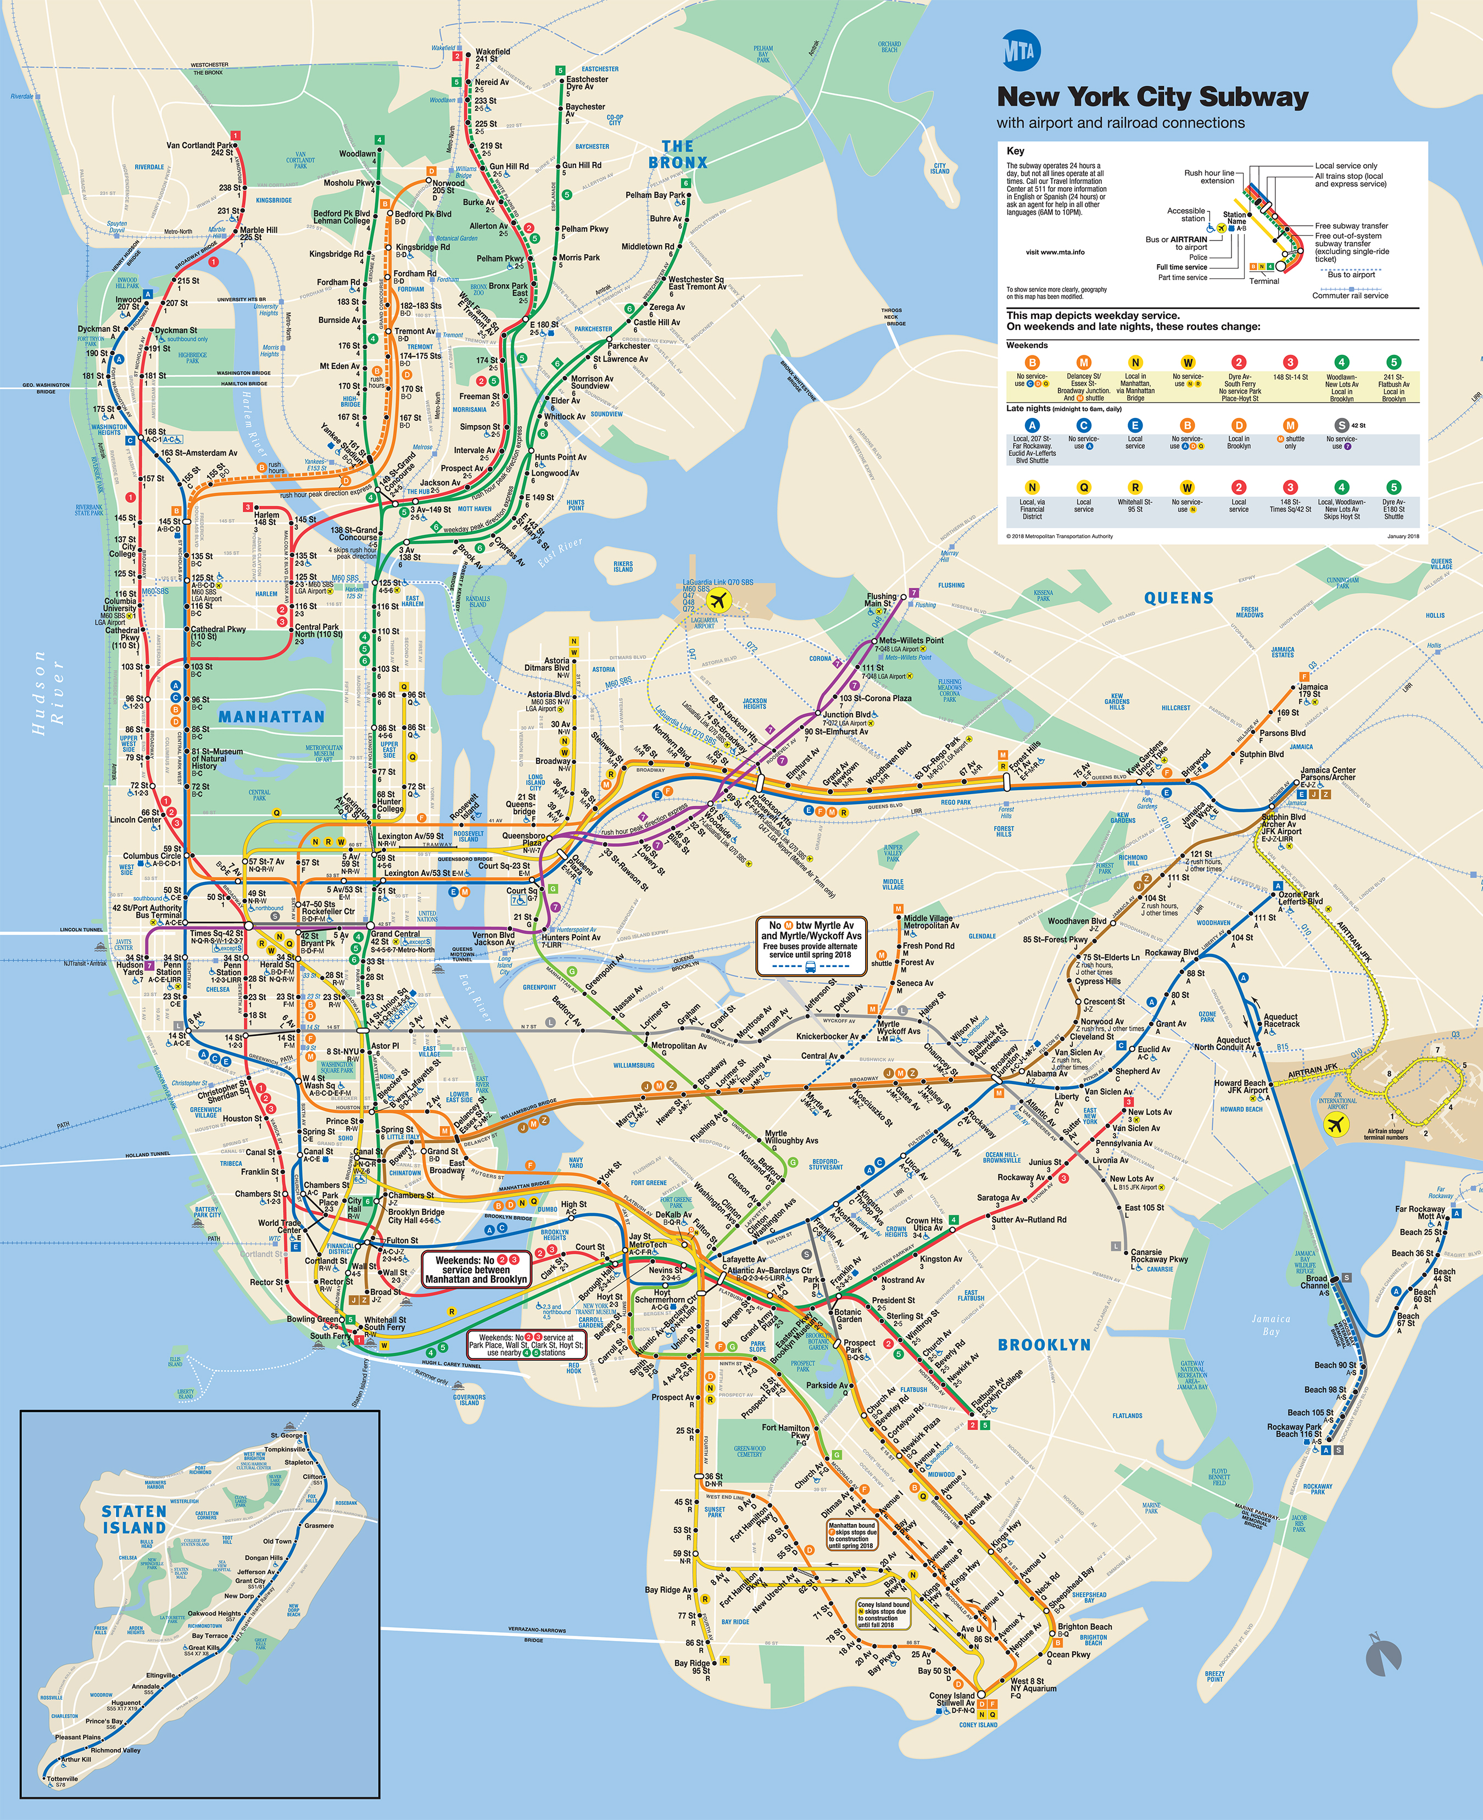
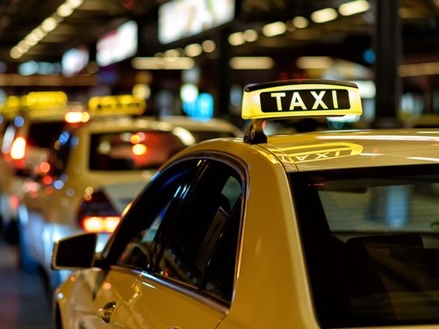
Focus:
Trying to determine which way of transportation Is best, either private or public.
We will determine this by averaging the time depending on the distance and the routes that need to be taken.

Slide 3
Public Transit
-Train stops, and routes
-Bus stops, and routes
-Data was collected from
http://web.mta.info/developers/developer-data-terms.html#data
Data was downloaded as txt files

Slide 4
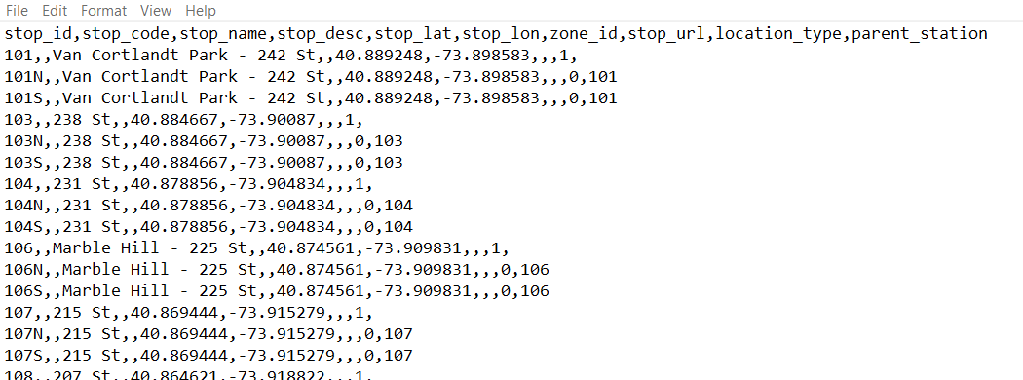
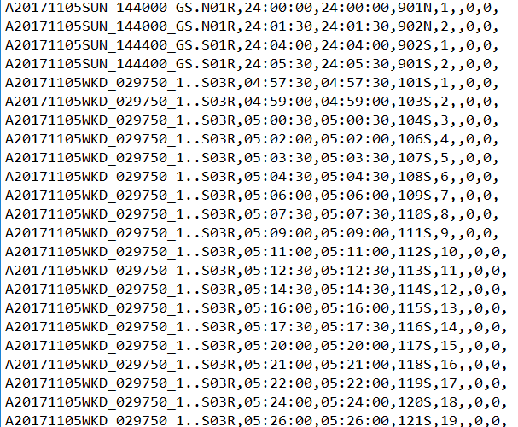

Slide 5
Private Transit
-Collection of Yellow and Green taxis.
-Also in files, saved as .csv (comma separated values) files through excel
Files were obtained from http://www.nyc.gov/html/tlc/html/about/trip_record_data.shtml
Cleaning up the data, to only obtain,
Start time, End time, and Distance(given);

Slide 6
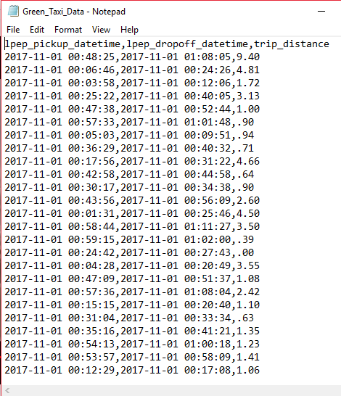
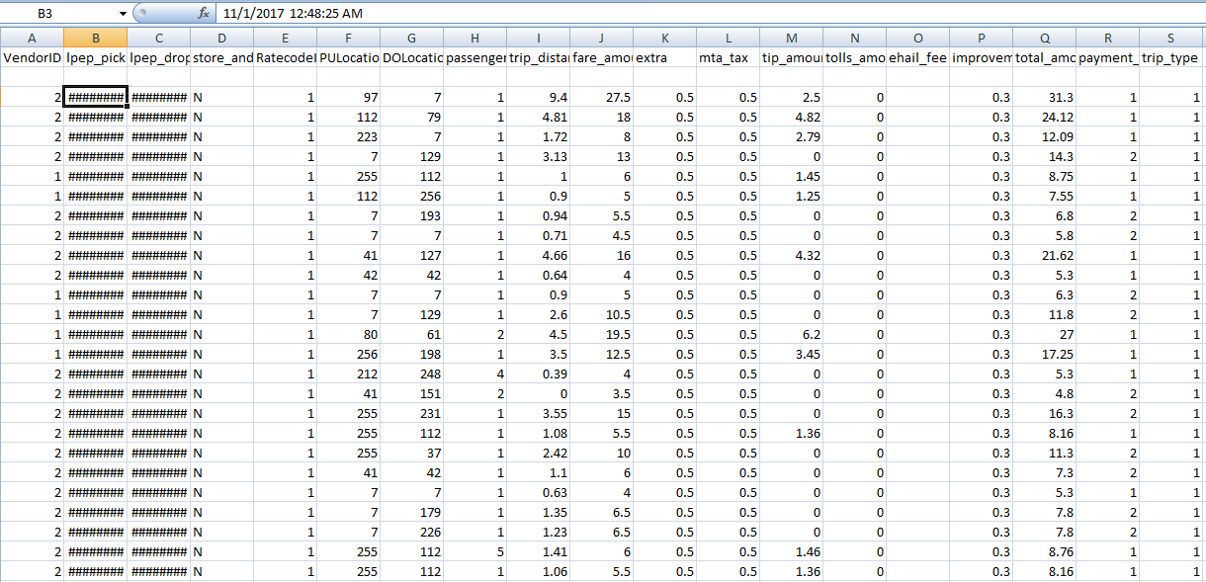
Data files for green and yellow taxis
Before
After

Slide 7
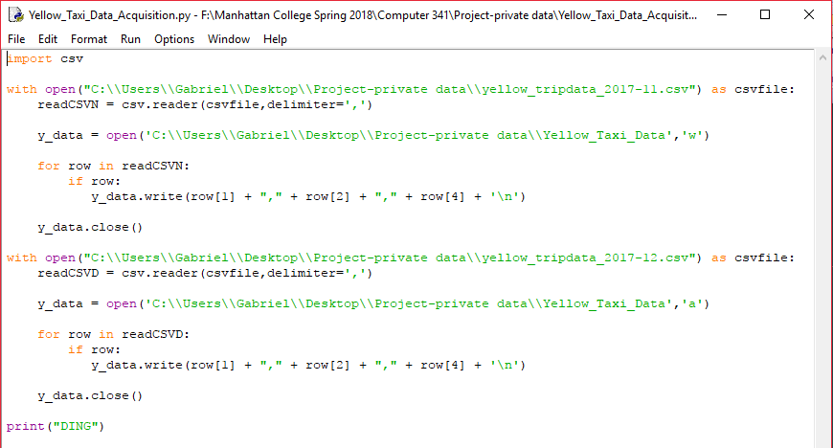
Picture of code(Yellow Taxis)

Slide 8
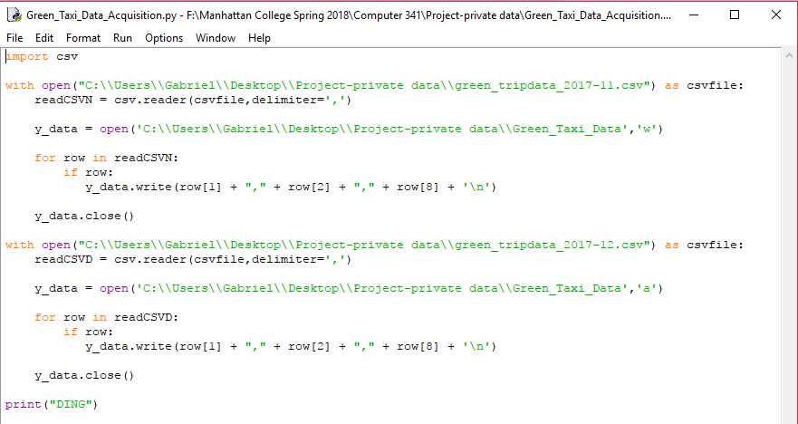
Picture of code(Green Taxis)

Slide 9
Moving forward
To know which would be a better option, calculating time will be our best way of analyzing which to take.
We picked 4 locations
Determine distance, with coordinates and possible routes,
Starting Pt. | End Pt.
137th St. City College(Harlem) | Coney Island(Bk)
Rockaway Park Beach(Bk) | Times Square(Manhattan)
Battery Park(Manhattan) | Bronx Botanical Garden(Bx)
Manhattan College | World Trade Center (Manhattan)

